Slide 1

A Year Fuzzing XNU Mach IPC
Nguyen Vu Hoang (Peter)

Slide 2
About me
Nguyen Vu Hoang (Peter), Security Researcher at STAR Labs.
Focusing on macOS/iOS bug hunting and exploitation.
✅ Awarded bounties by Apple Security Platform.
✅ Found some vulnerabilities in Apple from userland to kernel-level vulnerabilities

Slide 3
Outline
Previous XNU Mach IPC Vulnerabilities
Template-based XNU IPC Fuzzer
CVE-2022-32894
Q&A
References

Slide 4

1. Previous XNU Mach IPC Vulnerabilities

Slide 5
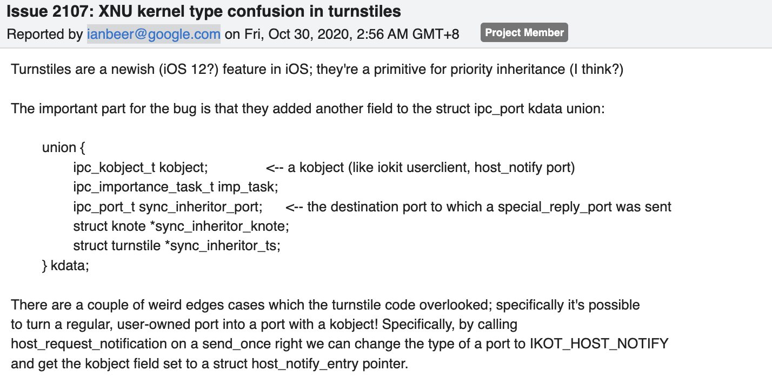
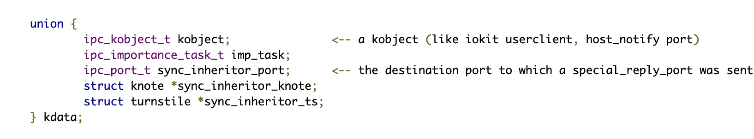
CVE-2020-27932 (1/2)

Slide 6
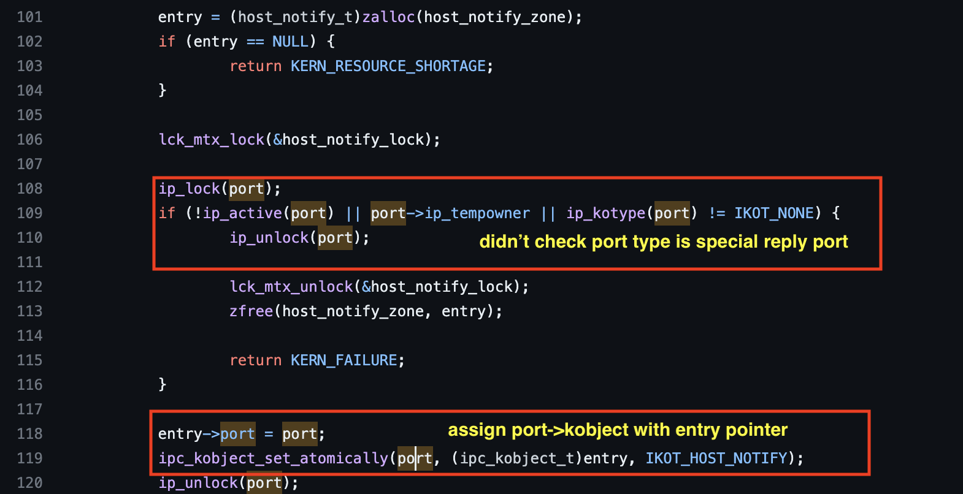
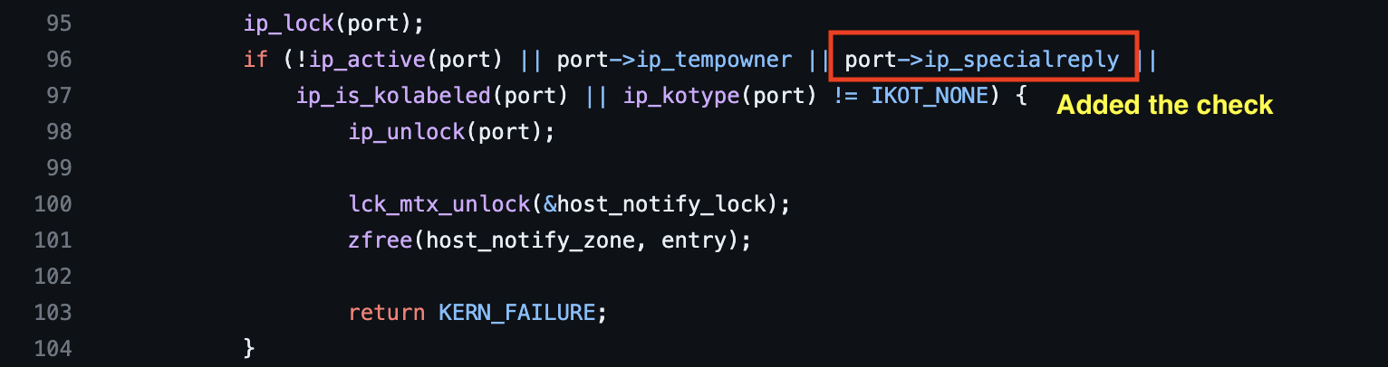
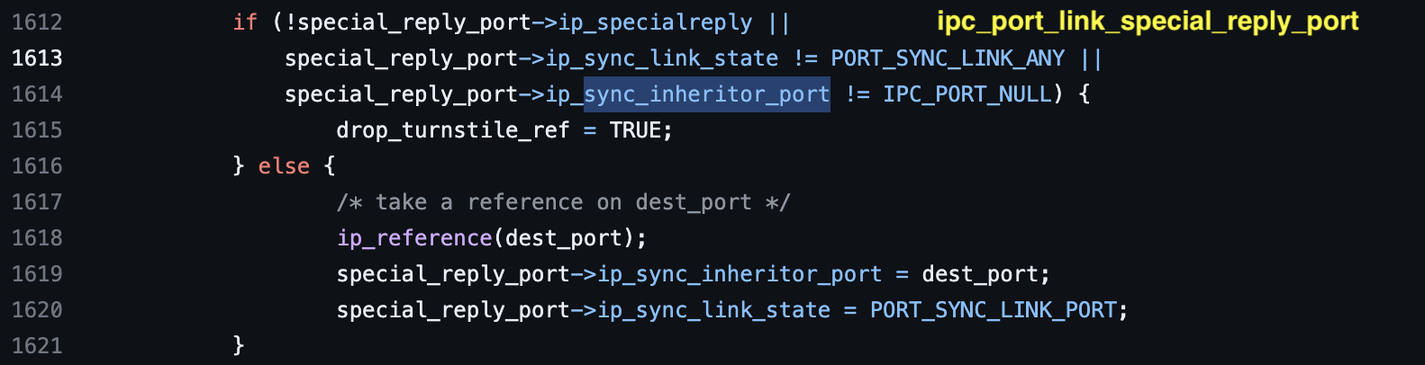
CVE-2020-27932 (2/2)

Slide 7
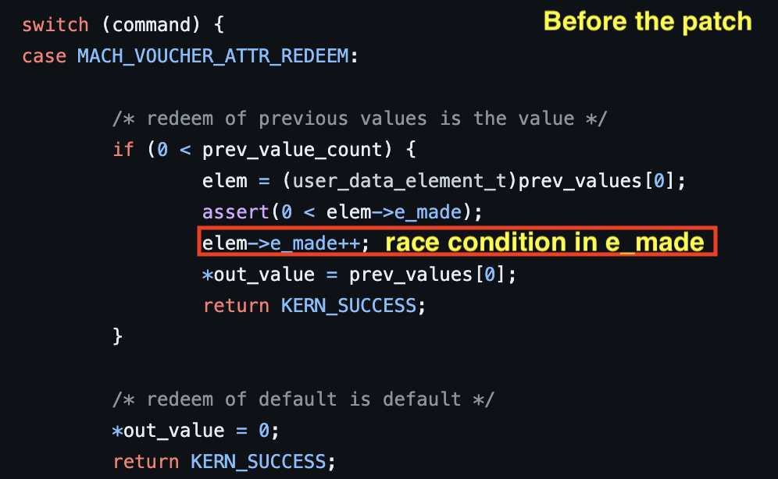
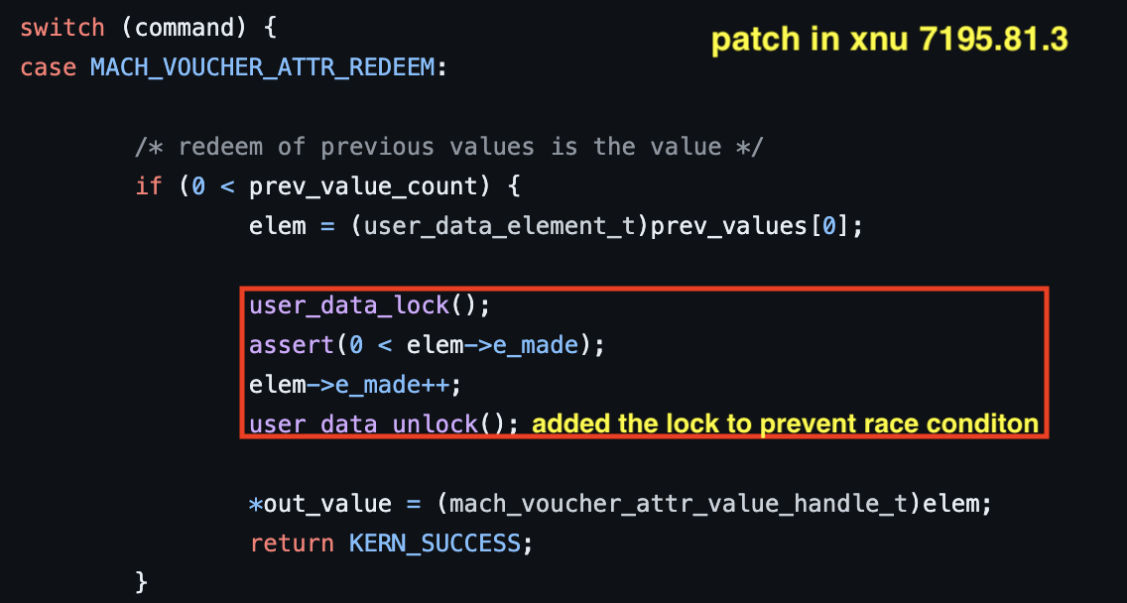
CVE-2021-1782

Slide 8

Key takeaways
Mach IPC subsystem has huge code paths and implements a lot of features which is not easy.
The union keyword is widely used in object declarations, especially in mach port structure to store multiple type of objects.
These could lead to side effects which might cause high impact in XNU kernel.

Slide 9
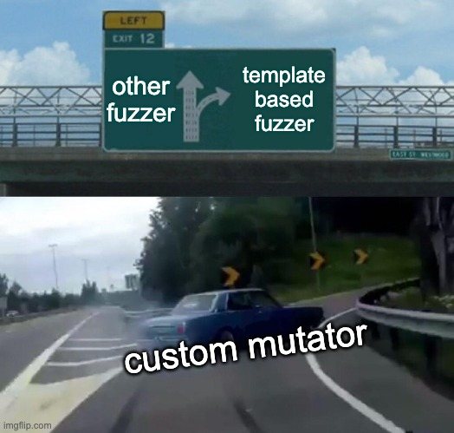
2. Template-based XNU IPC Fuzzer

Slide 10

What are the three challenges ?
Generating test-case using MACH IPC syscalls and their arguments in C language is very hard.
The code-base is huge. In order to reach these code paths, you have to satisfy may conditions.
Mutating Mach IPC syscalls and their arguments are not enough to expand the code coverage and hard to develop.
We need more advanced fuzzer which has ability to generate complex test-case and reach in deeper in Mach IPC.

Slide 11
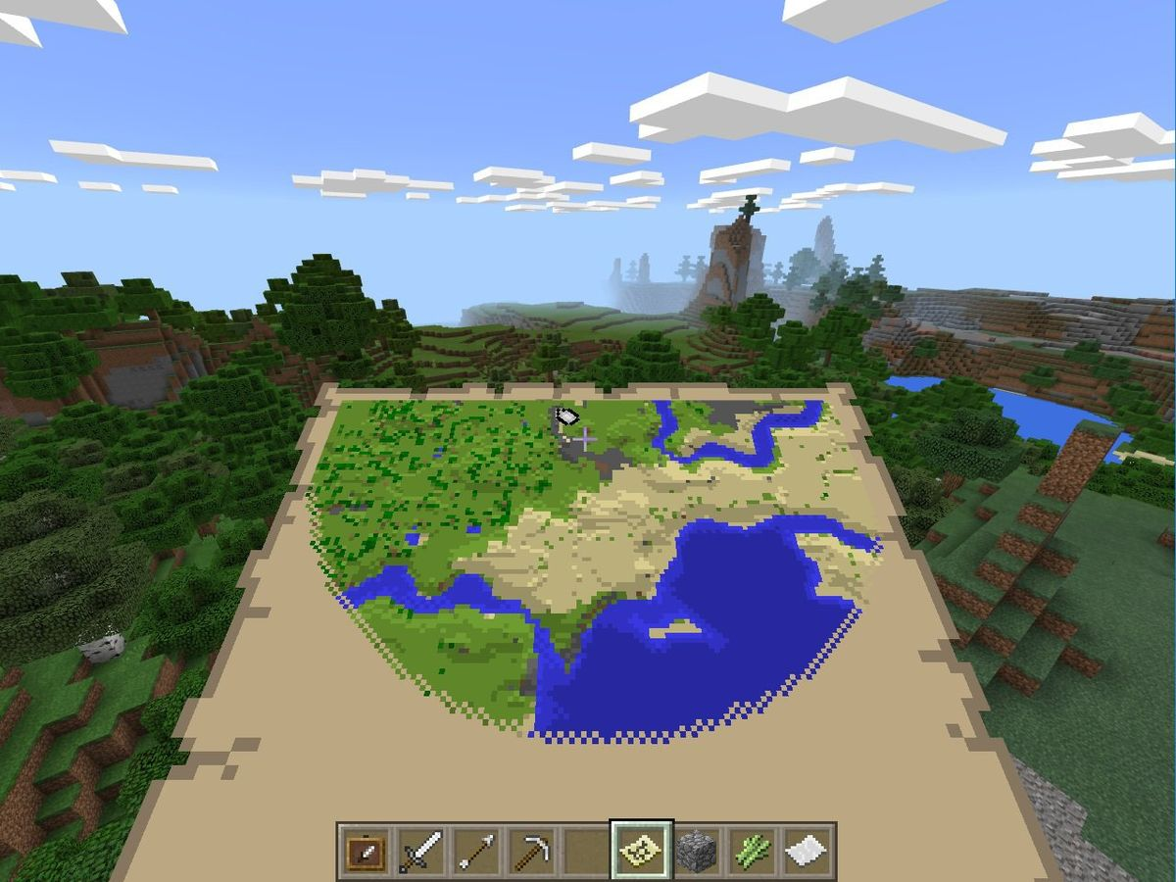
What are template-based fuzzer?

Slide 12

My expectations
The template based fuzzer have to easily to modify and edit template in C language.
The template design must be easy to parse and process (less coding 😃).
The template able to add some custom functions beside mach ipc syscall functions.

Slide 13
Fuzzer Architecture
Protobuf testcase
Fuzzer
C File
C Template

Slide 14
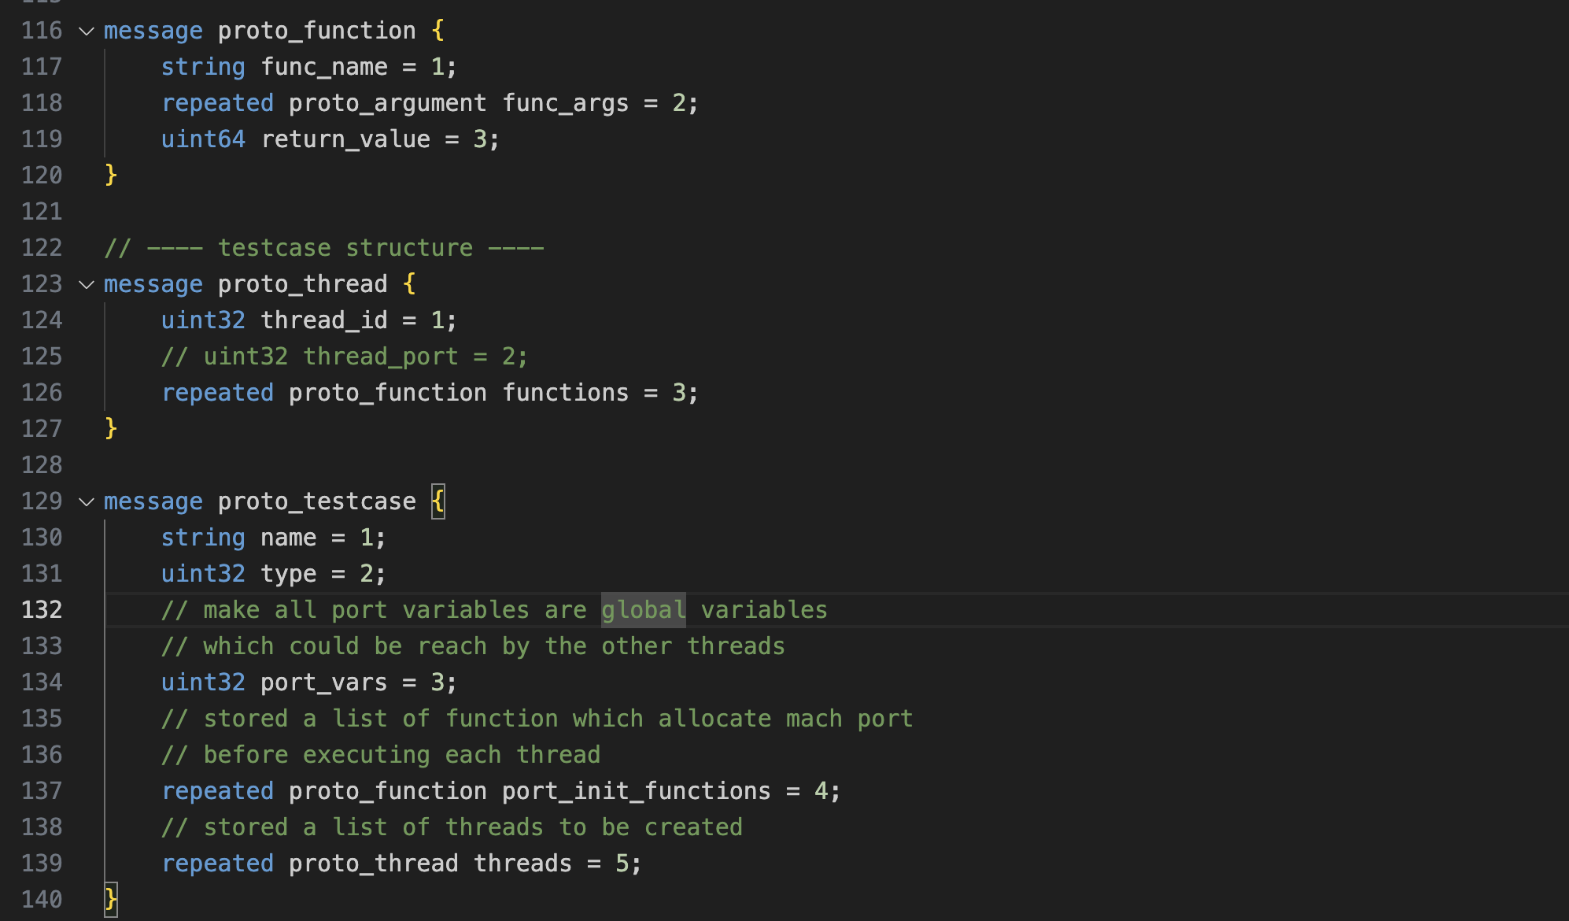
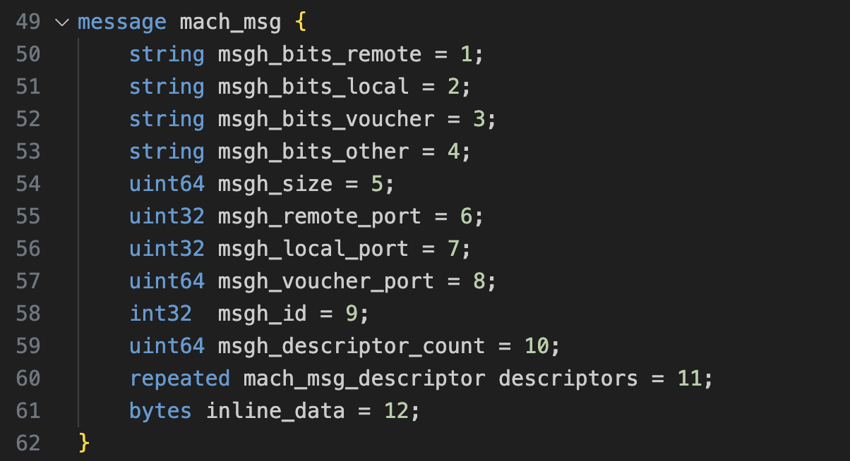
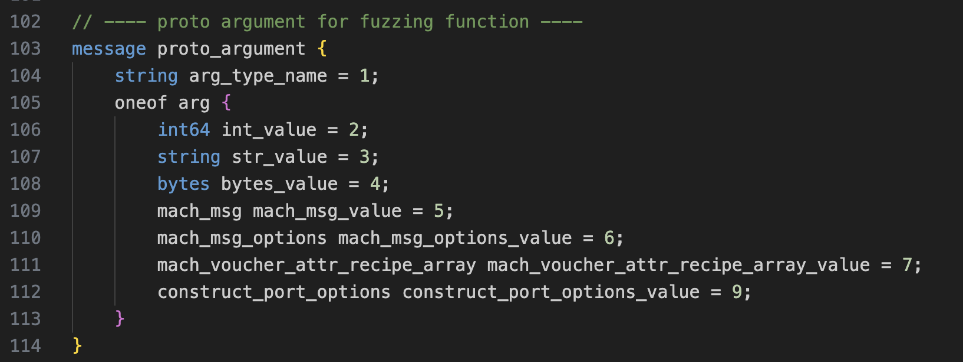
Fuzzer Architecture: Protobuf test-case
Protobuf is very friendly and easy to use in Python.
Protobuf test-case help me to mutate order of calling functions and their arguments without care about text parsing and processing.
Protobuf test-case also help me to quickly write a tool to triage test-cases.

Slide 15
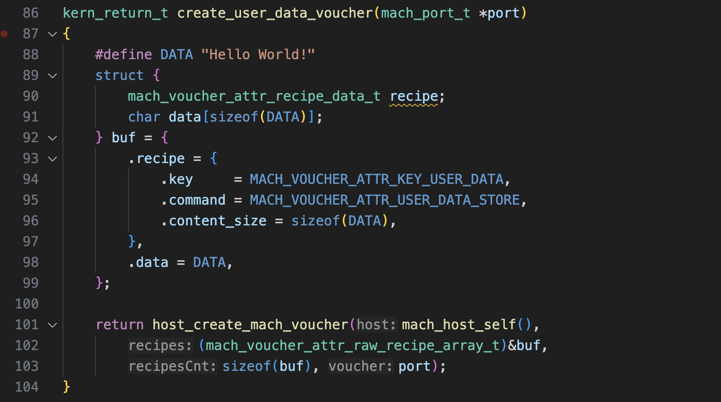
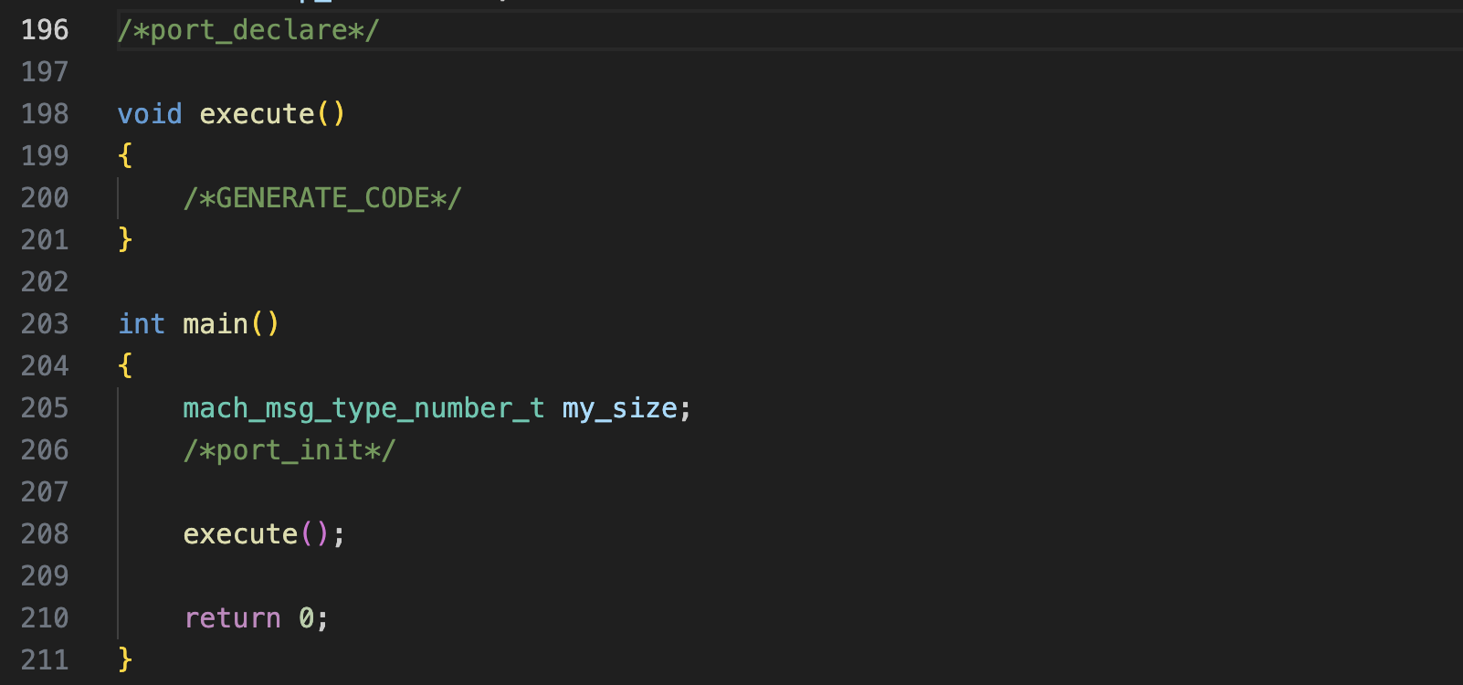
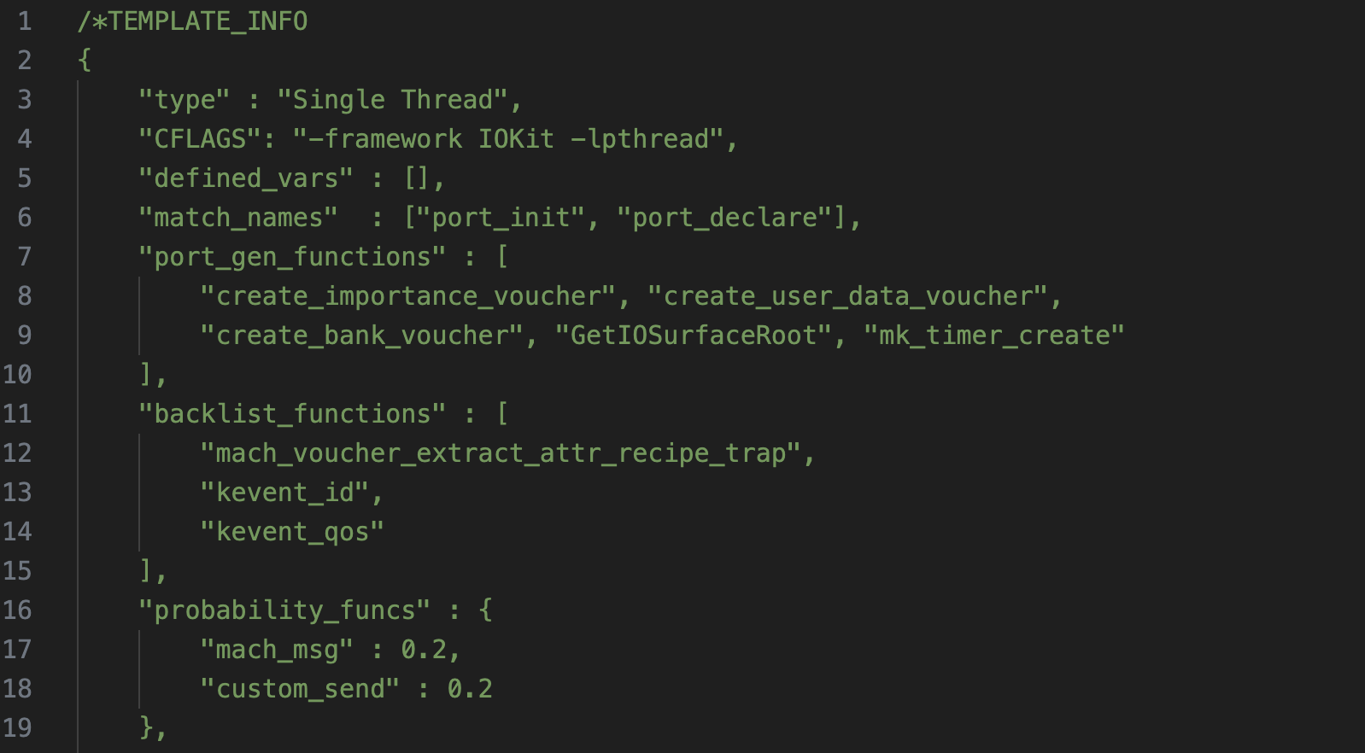
Fuzzer Architecture: C Template format
C Template format contains initial definitions, some defined variables and functions to be mutated.
C Template format also support some attributes allow mutators to correctly mutate the test-case.

Slide 16
Fuzzer Architecture: The Fuzzer
C Template
Mutator
Template Processor
Protobuf Testcase
C Test-case

Slide 17

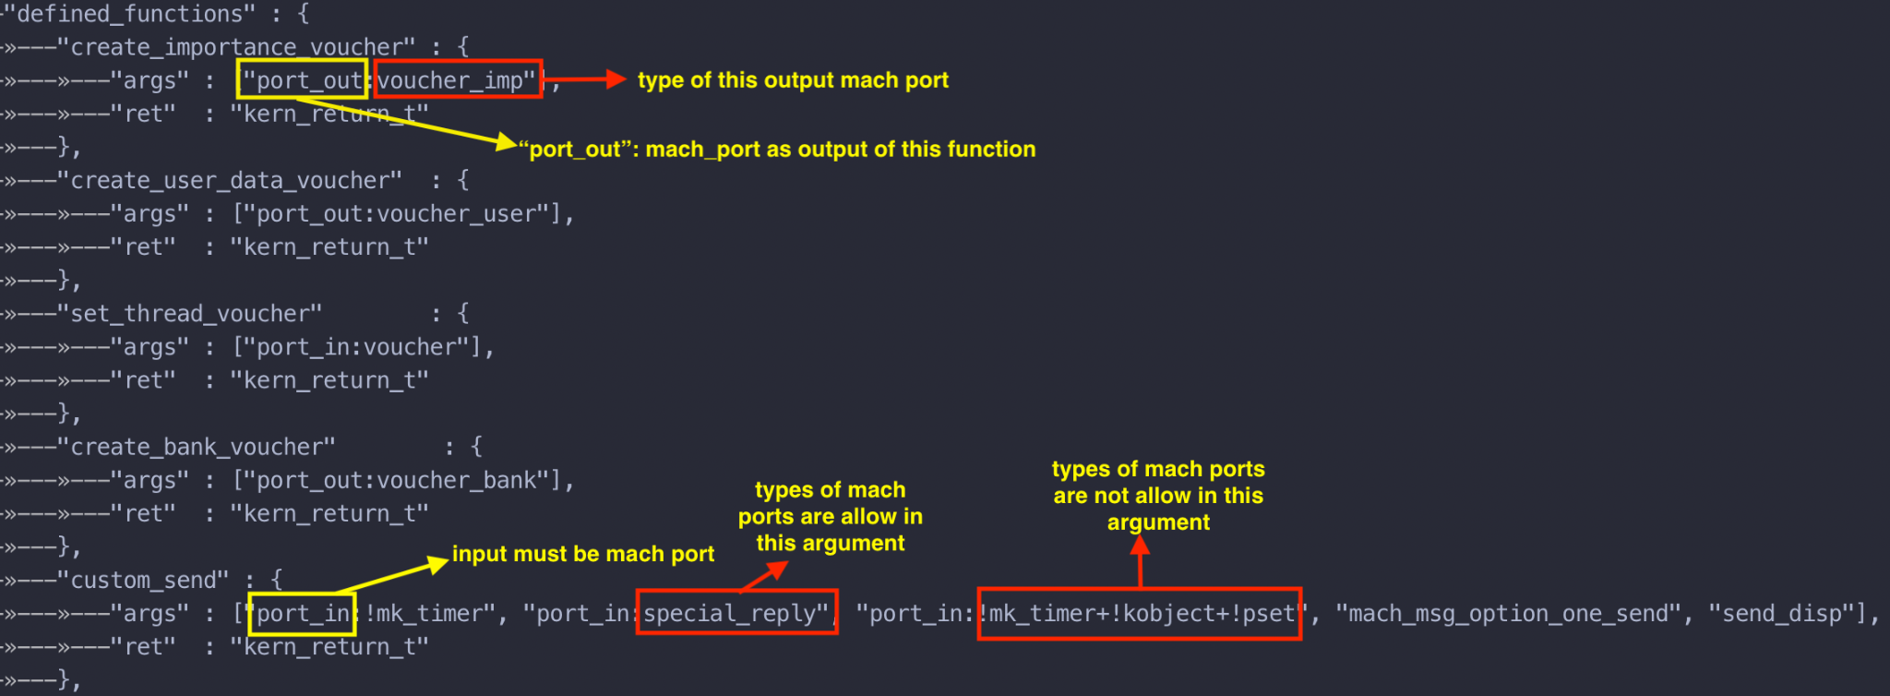
Template Processor (1/2)
Distinguish mach port by type
⌙ → correctly mutate arguments to reduce the error cases
⌙ → increase more chances to reach deeper in kernel 👌

Slide 18
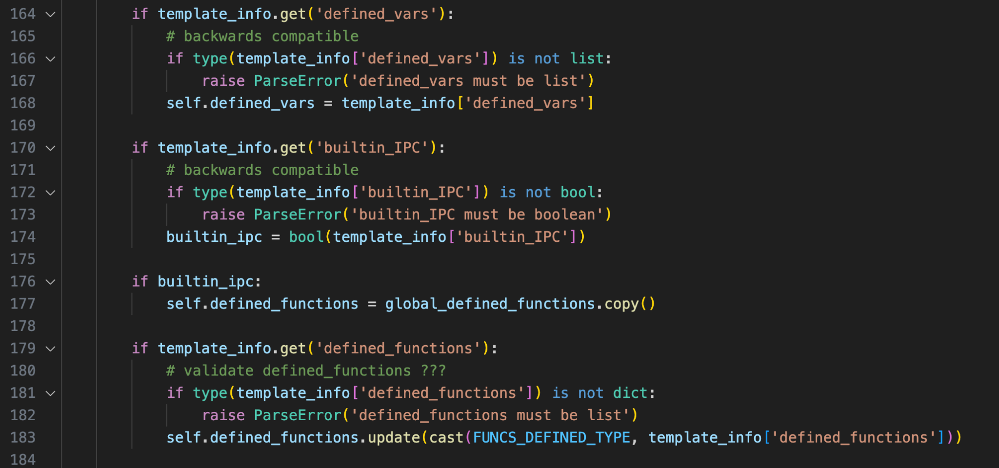
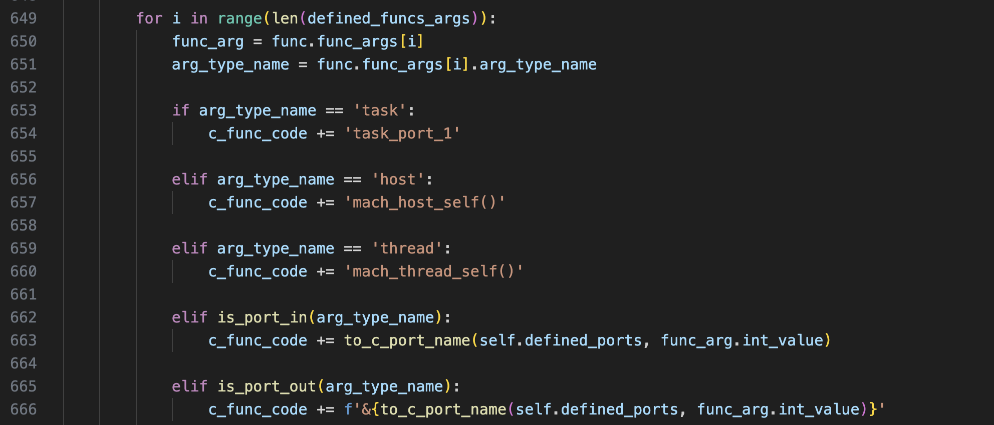
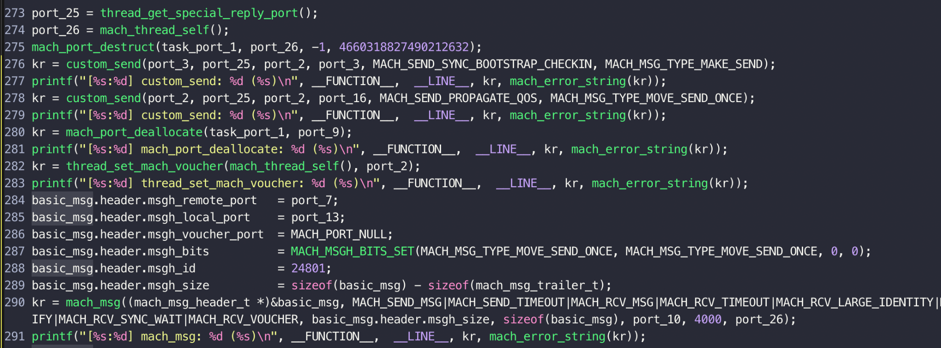
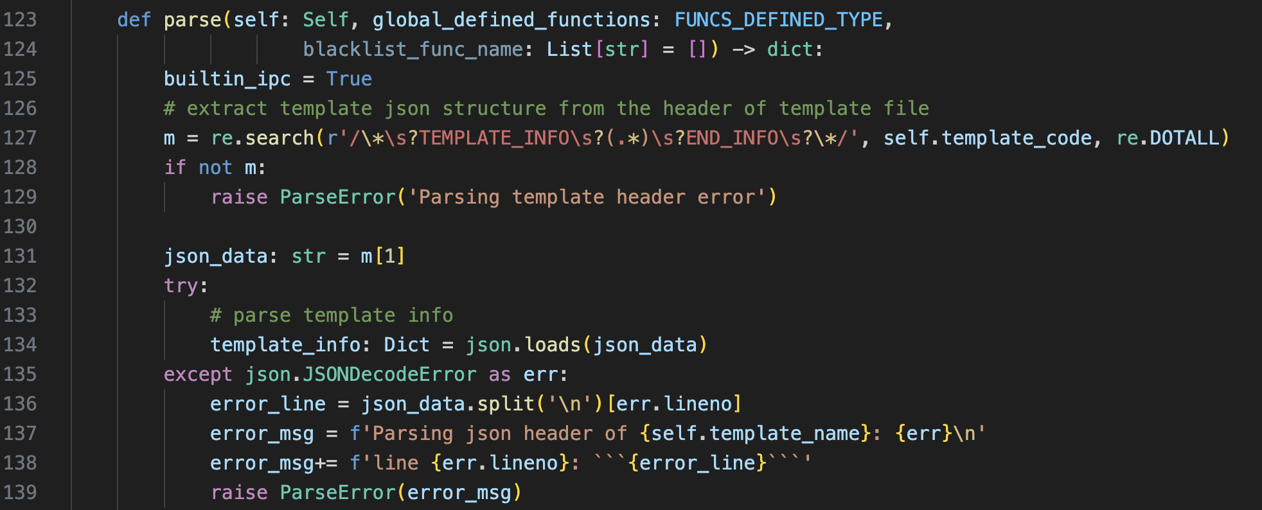
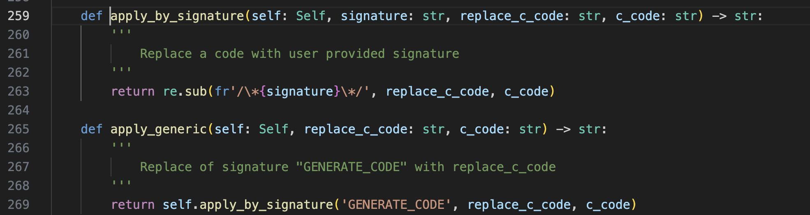
Template Processor (2/2)

Slide 19

Mutator
Mutator strategies:
Mutating function arguments base on their types (defined in C Template).
Mutating the order of calling these functions.
Mutating function bases on their probabilities defined in C Template.
Mutating the order of each threads to focus on race condition cases.

Slide 20
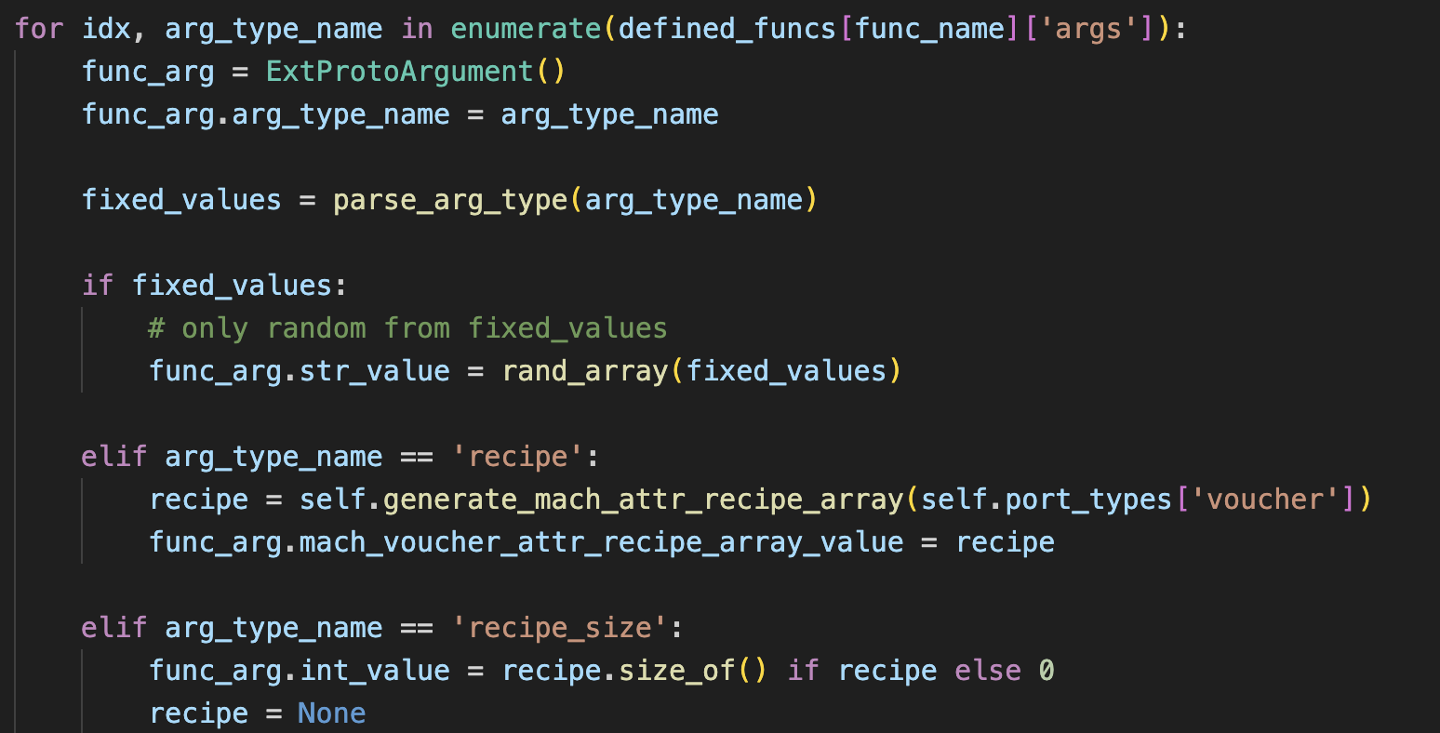
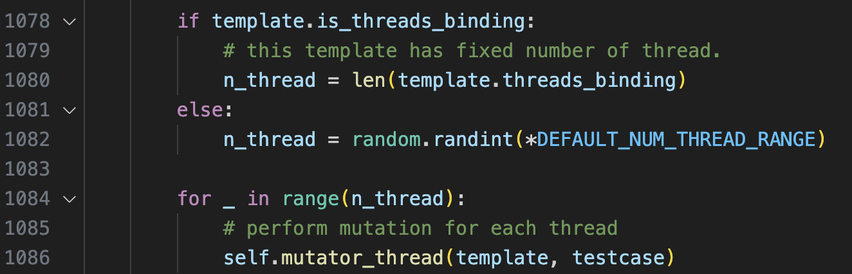
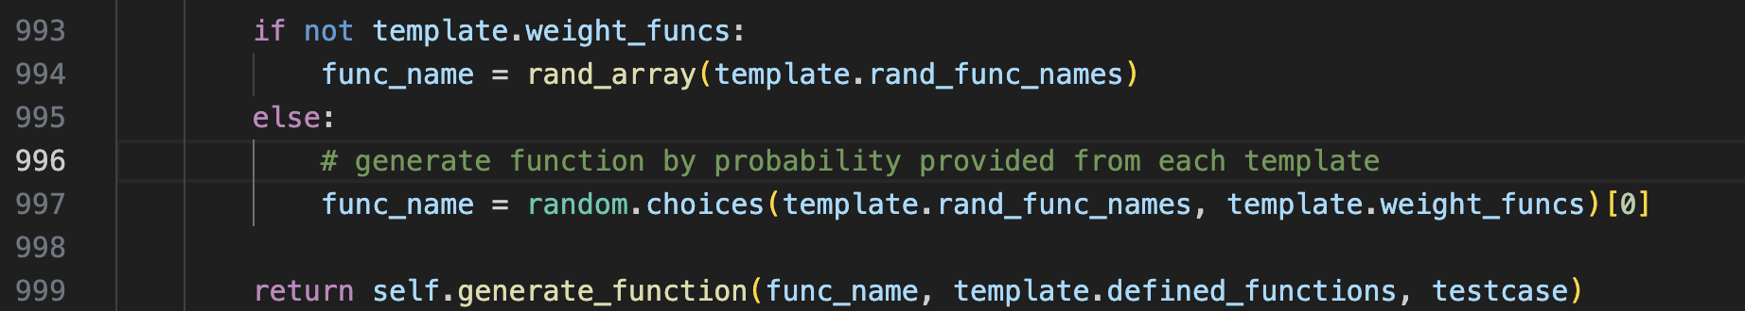
Mutator

Slide 21
How do I handle kernel panic? (1/2)
RECV test case from vm
Crash Monitor
Virtual Machine
MONITOR kernel panic
Fuzzer

Slide 22
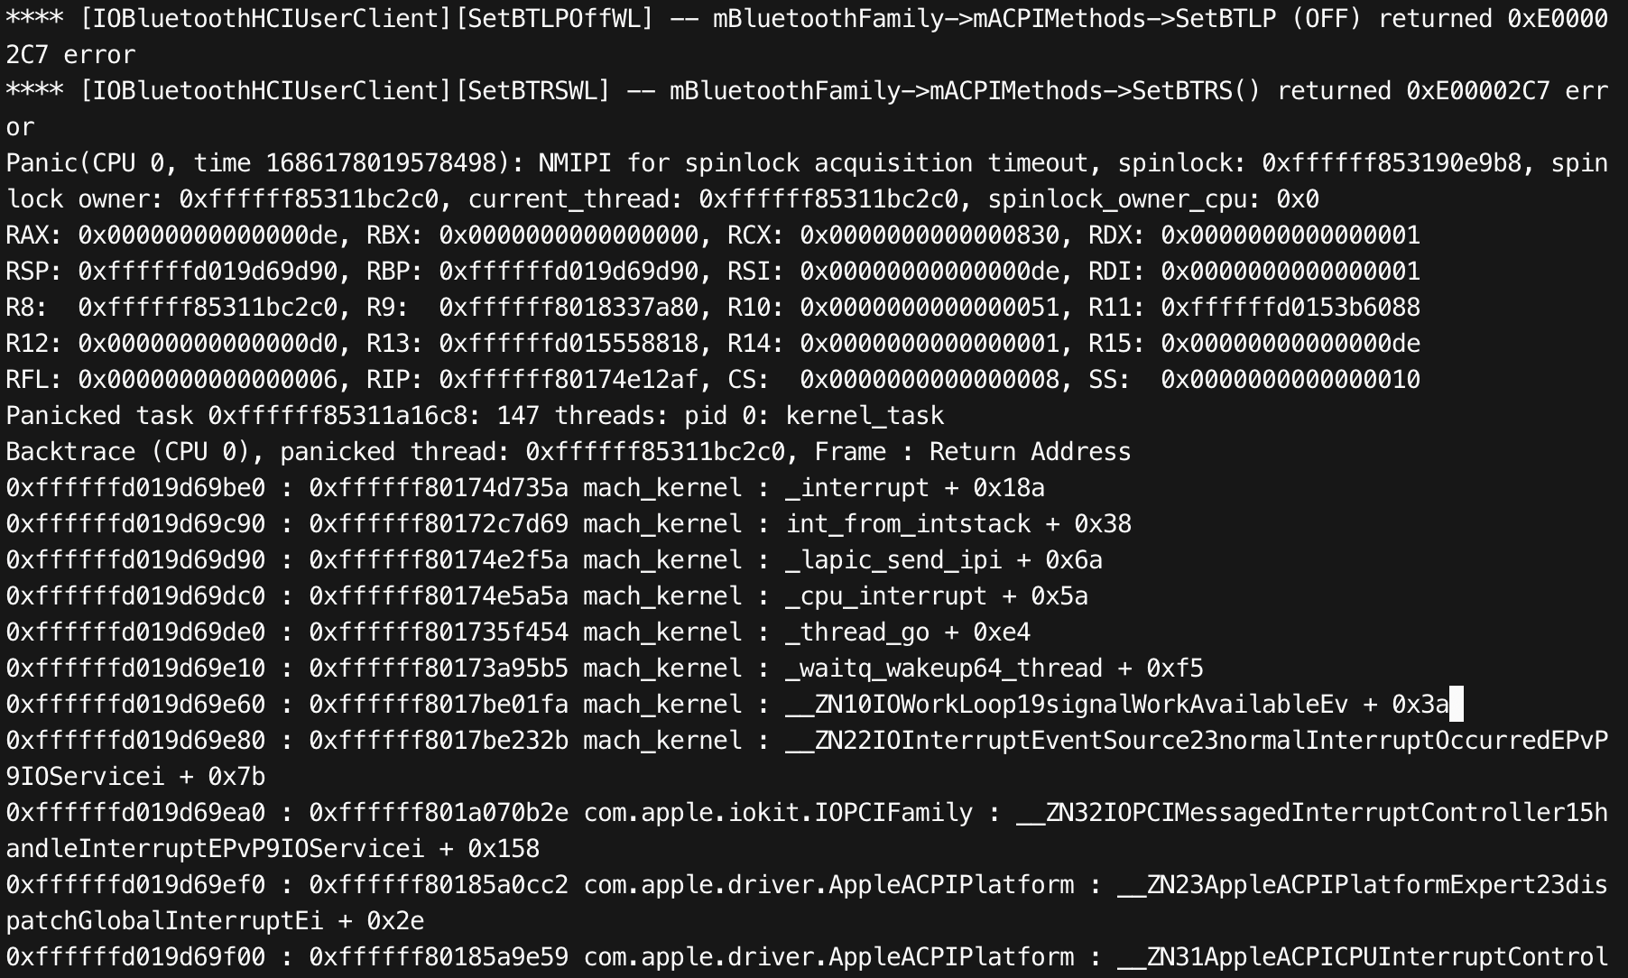
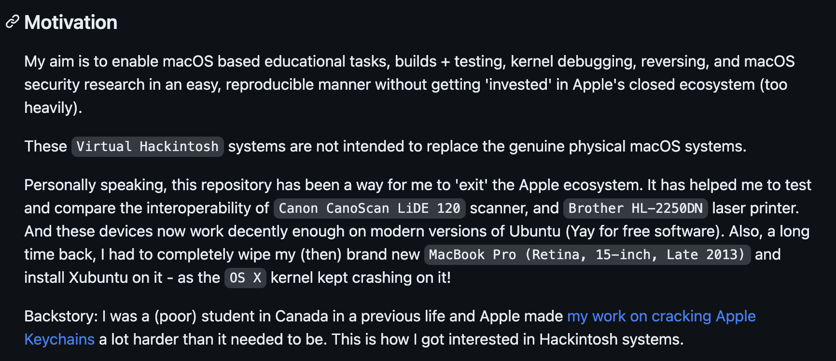
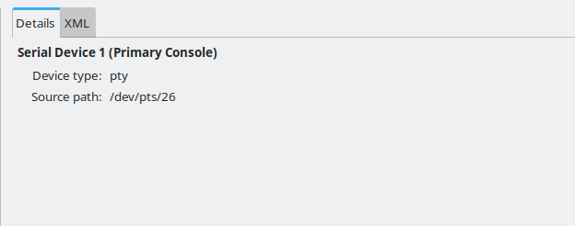
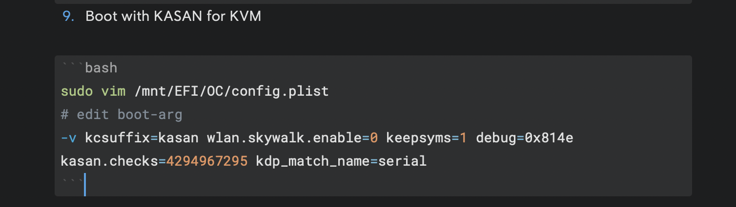
How do I handle kernel panic? (2/2)

Slide 23

Fuzzing Results
My fuzzer is written in Python around 2500 lines of code .
Auditing XNU kernel to create template and prepare for fuzzing and I have found a lot of crash after few days.
Found a lot of crashes. But there are some valuable crashes: CVE-2022-32894, CVE-2023-32441 (which was patched in iOS 16.6).

Slide 24

Key takeaways
The idea of fuzzing is the most important factor to discover security vulnerabilities.
Stick with code auditing beside with fuzzing to improve the mutator.
Have a deep knowledge about the target before fuzzing and you will find your own bugs.

Slide 25
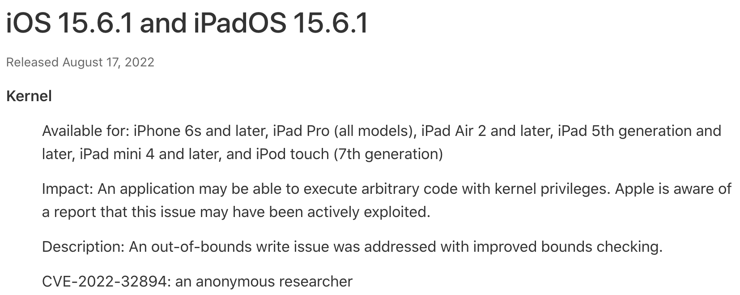
3. CVE-2022-32894

Slide 26
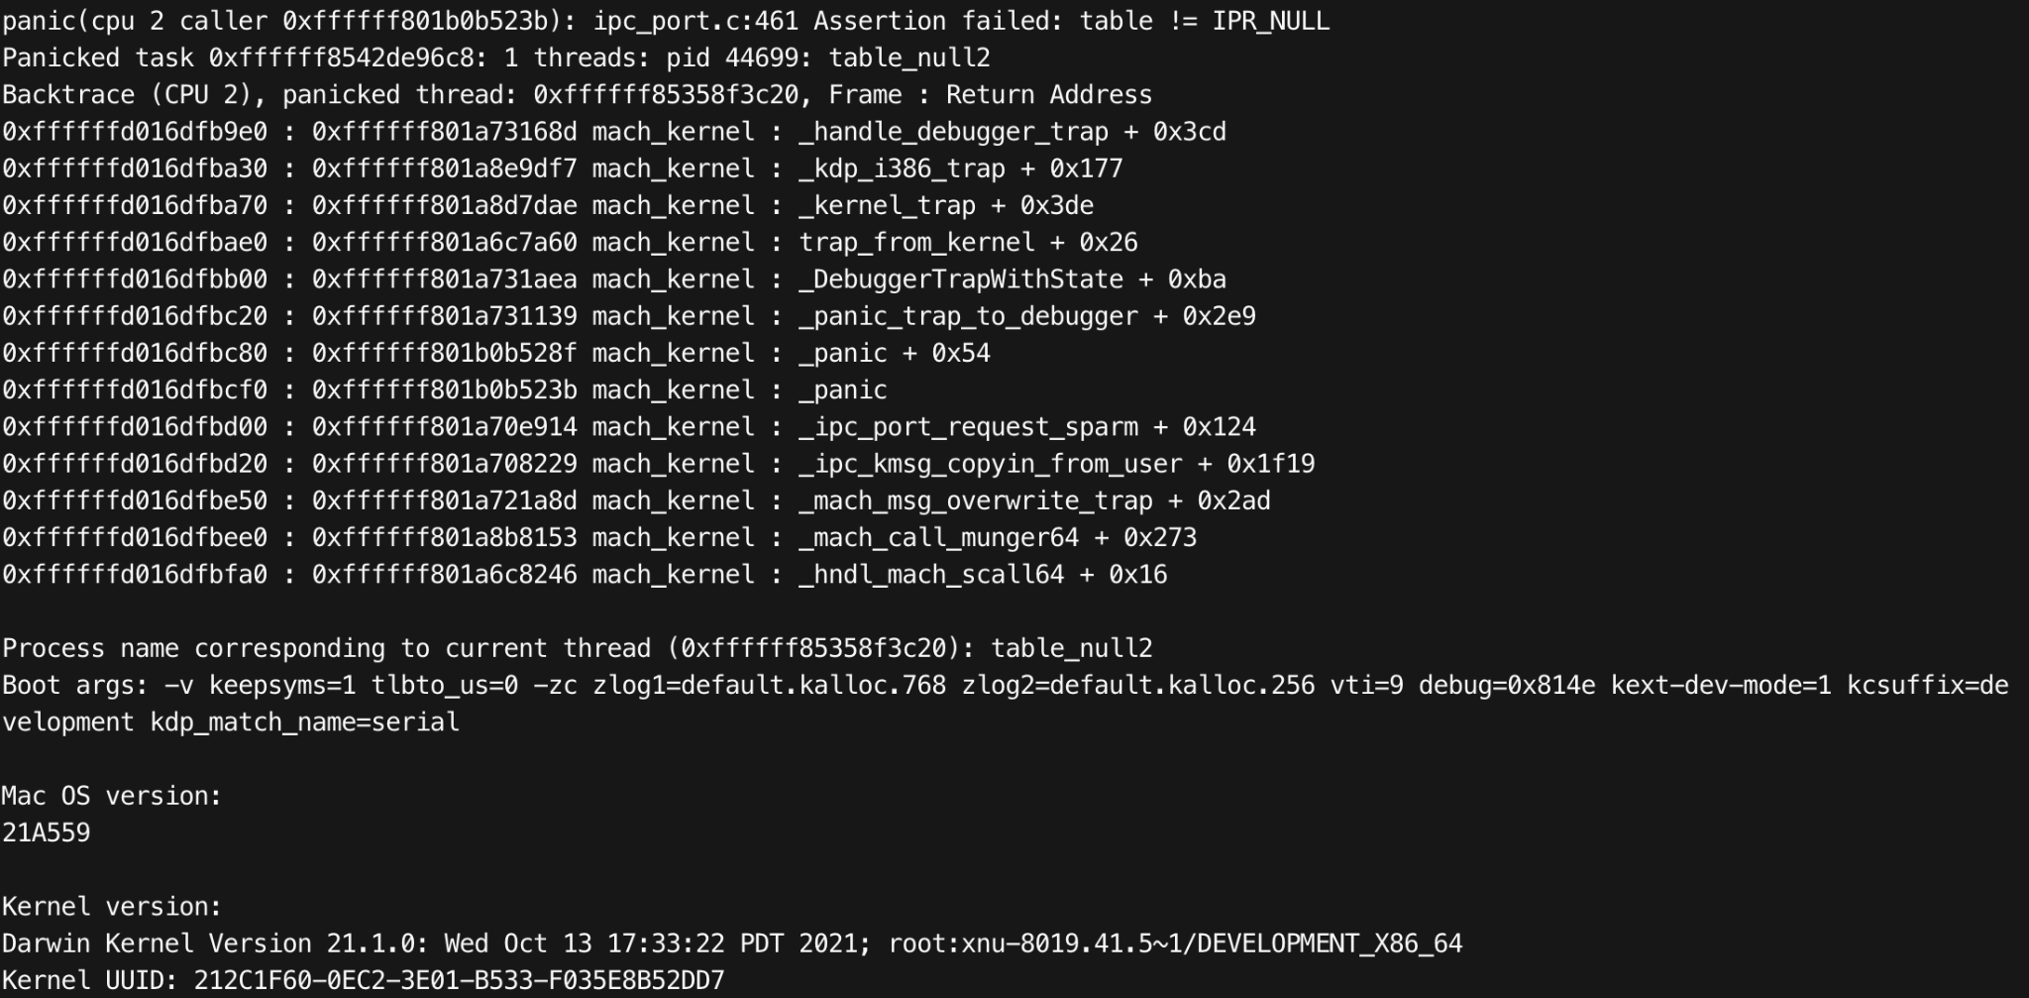
Fuzzing Results

Slide 27
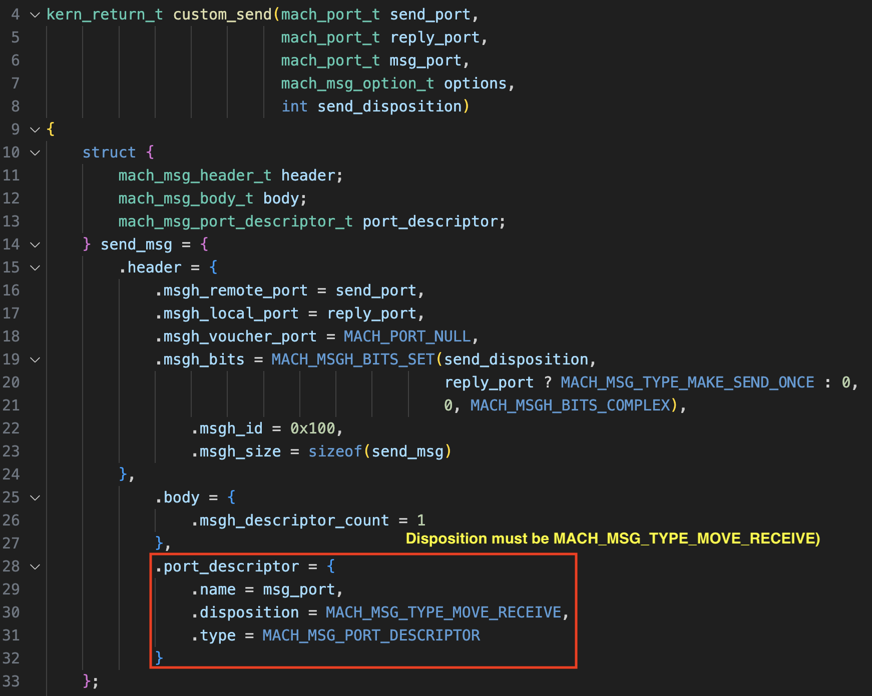

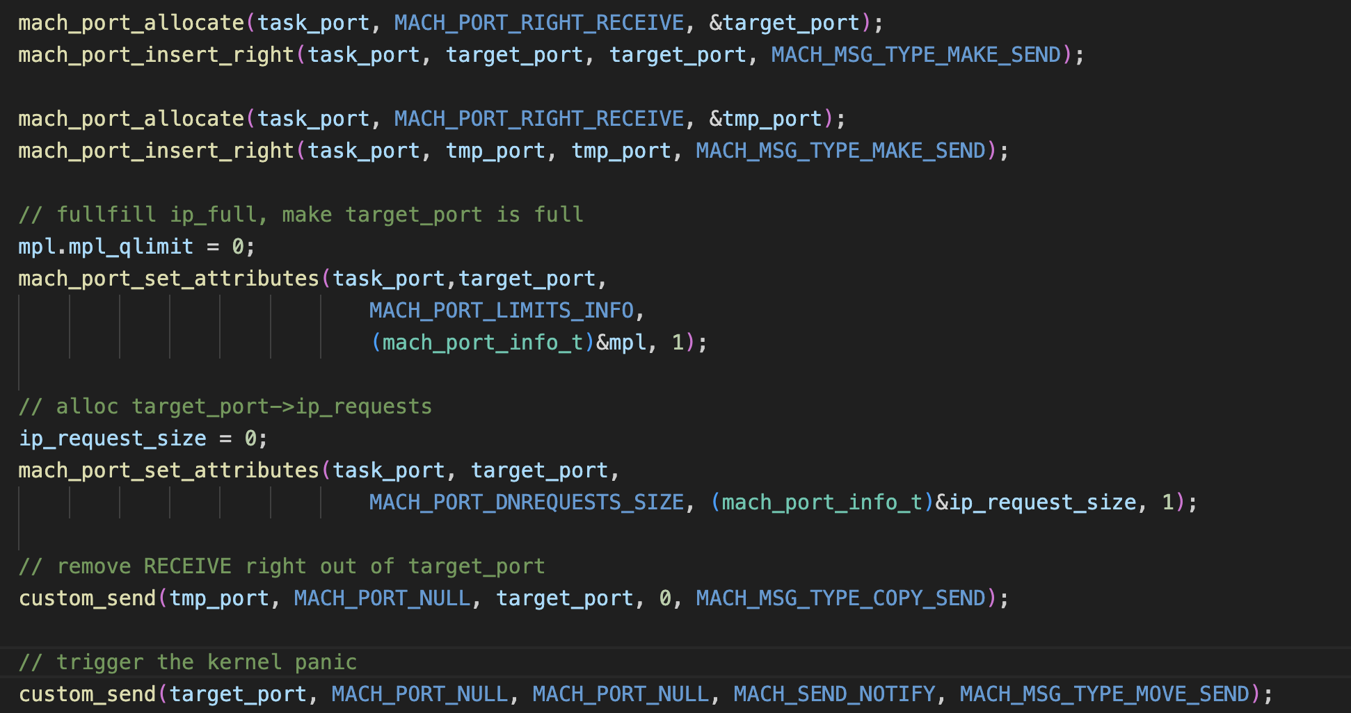
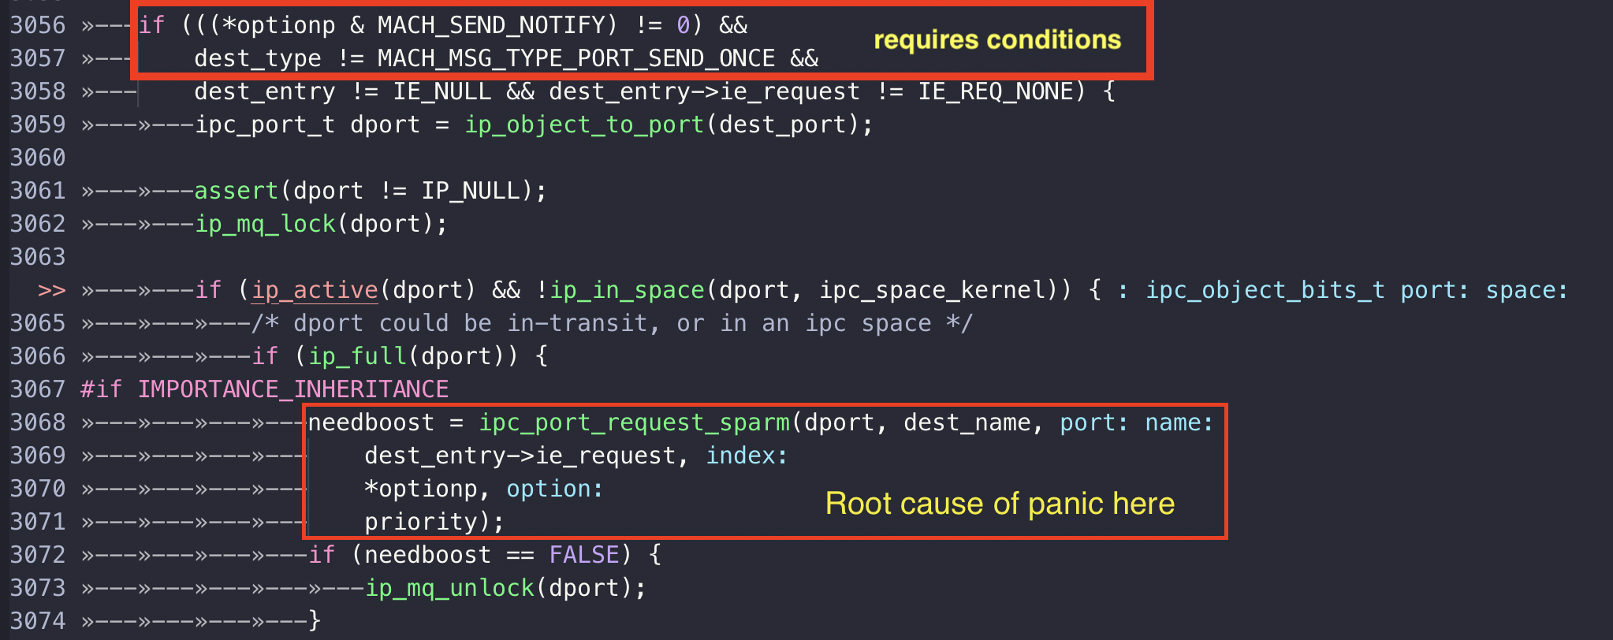
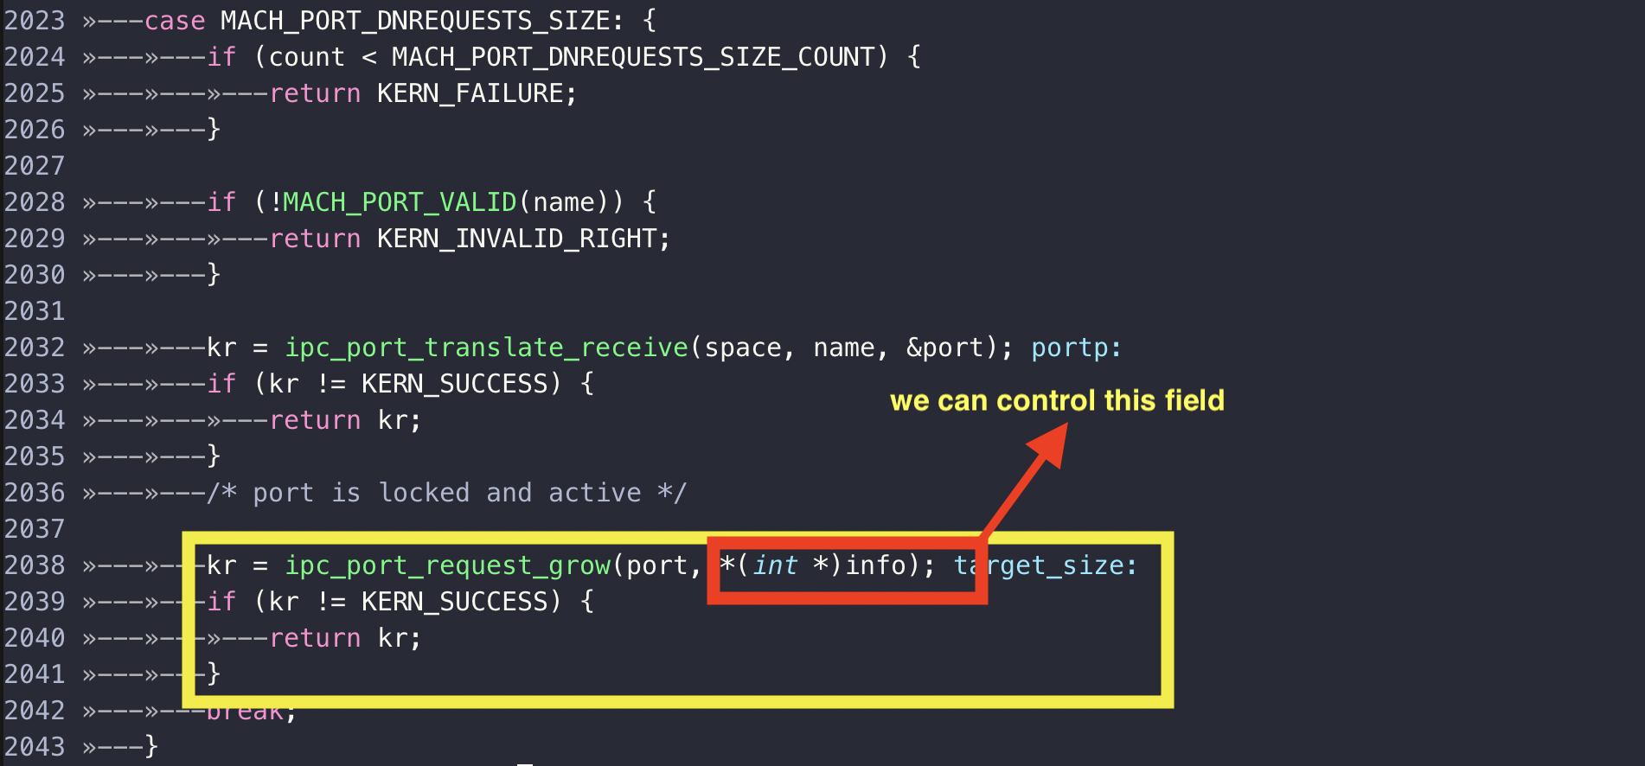
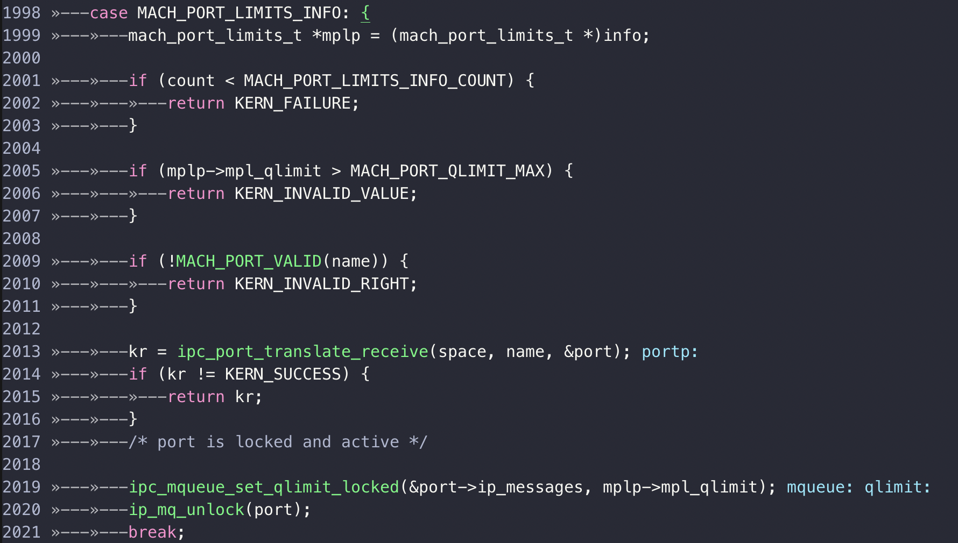
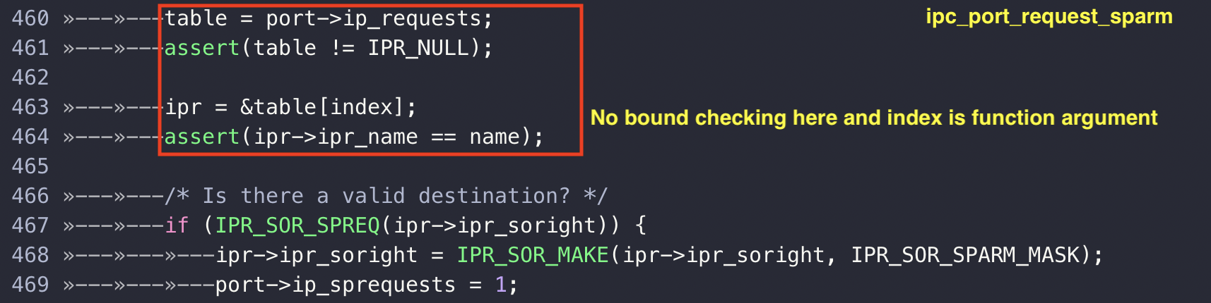
Root Cause (1/3)

Slide 28
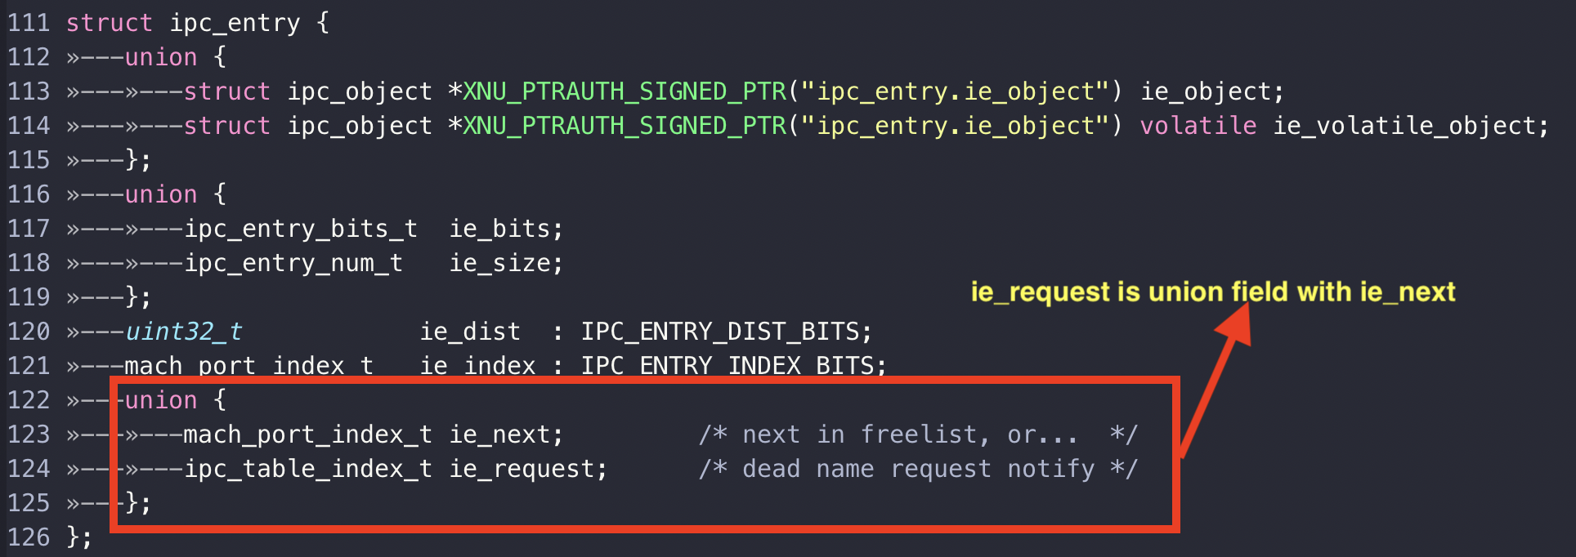

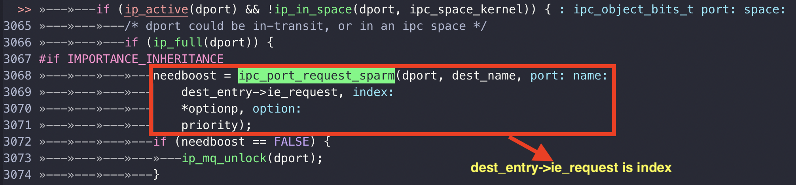
Root Cause (2/3)

Slide 29
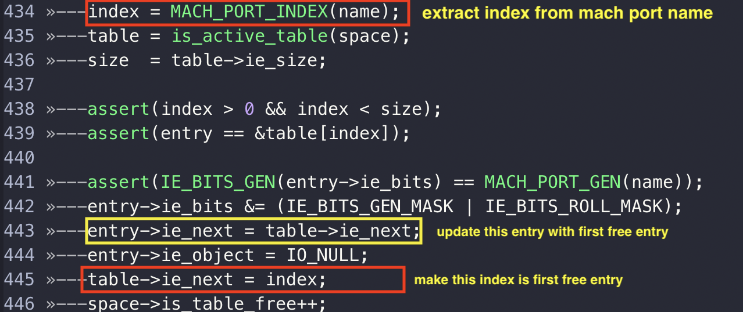
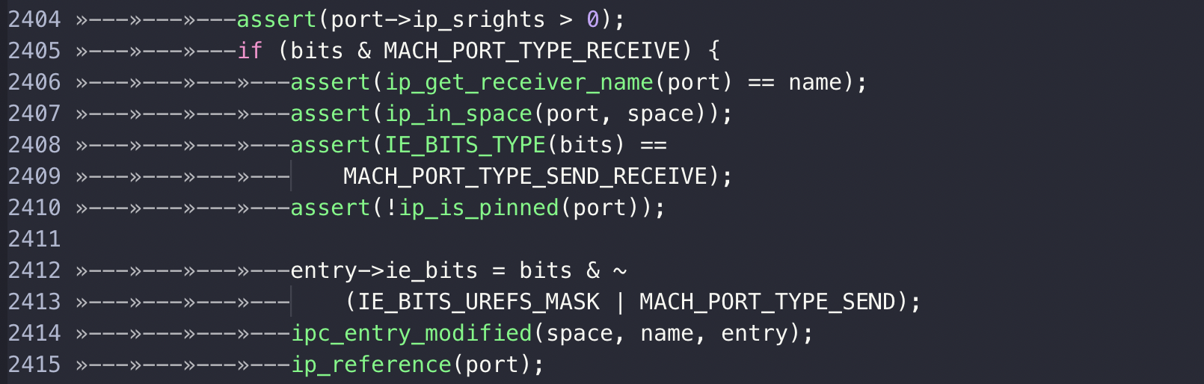
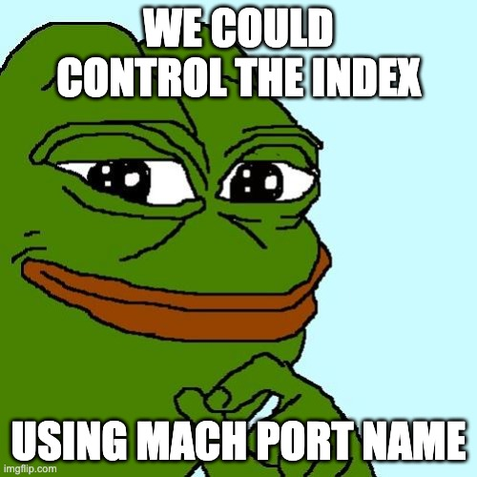
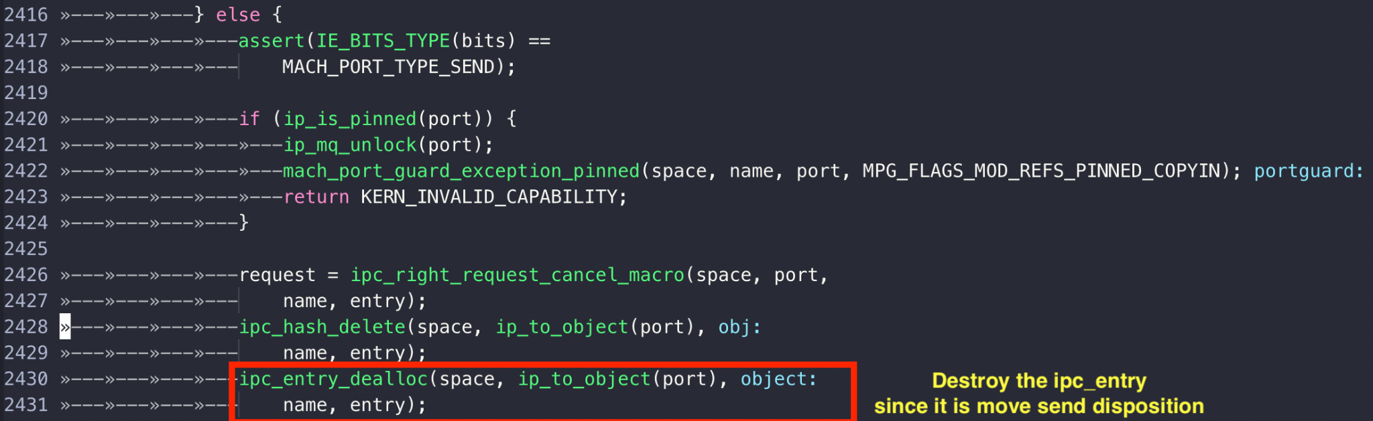
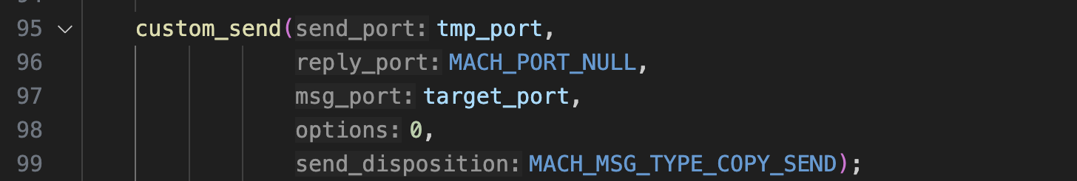
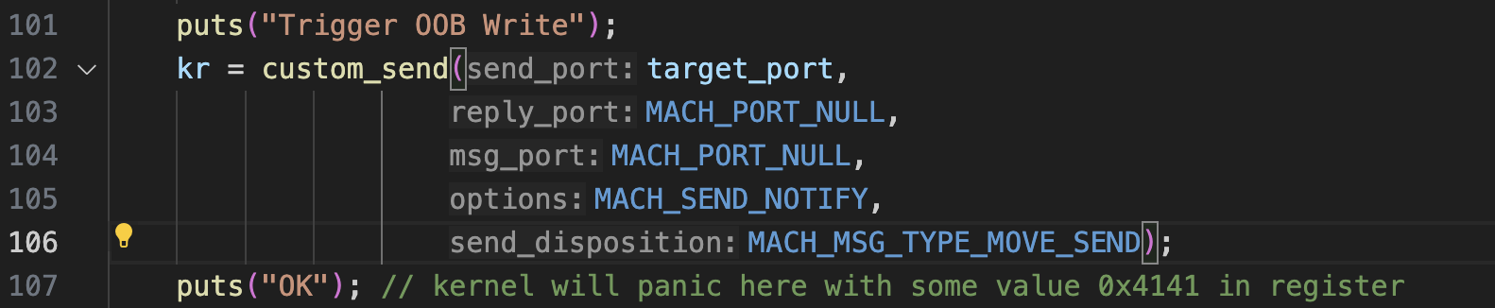
Root Cause (3/3)

Slide 30
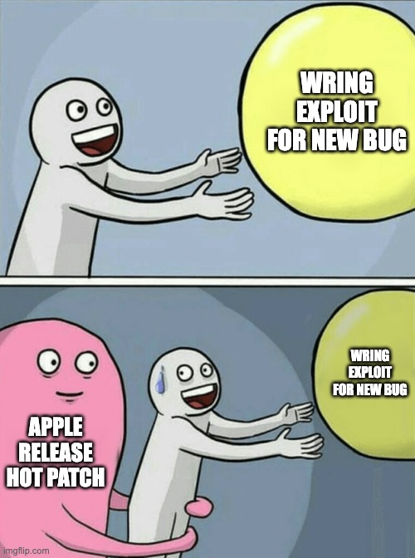
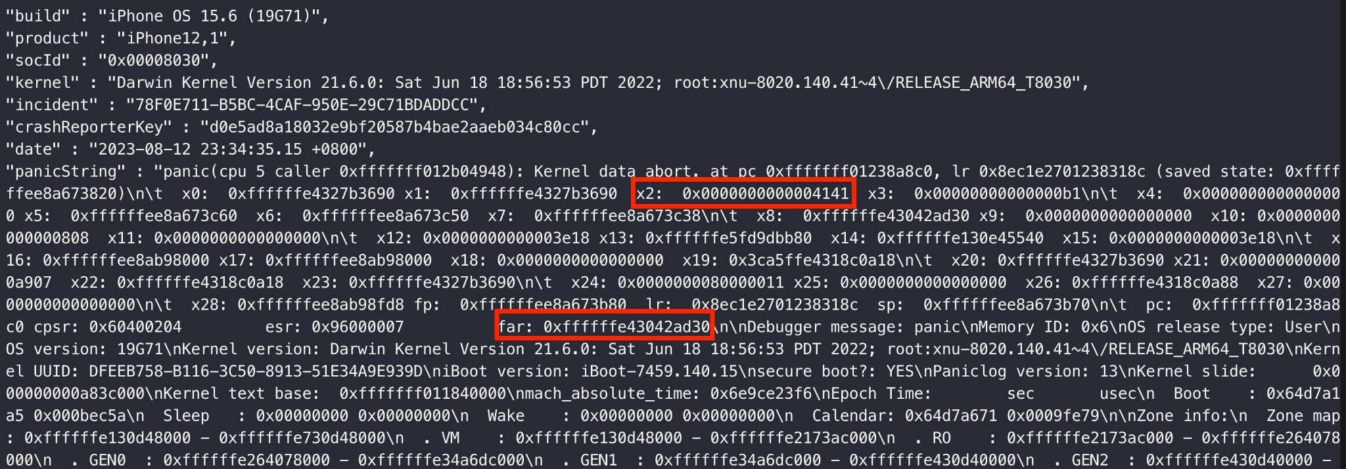
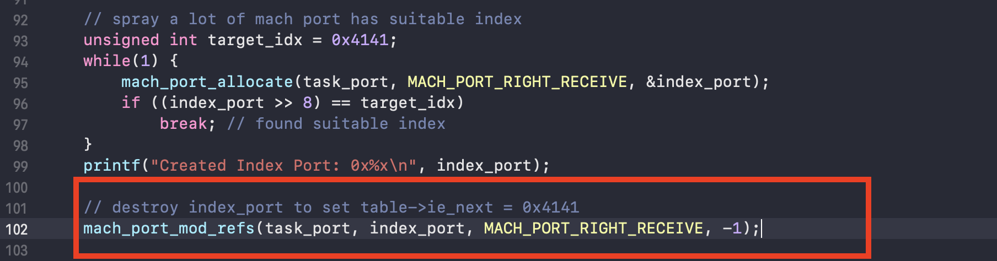
Mach Port Spraying

Slide 31
Key takeaways
Mach port is very complex and it use a lot of “union” in their structures which could lead to some side effects.
With ability to generate test-case from custom template, my fuzzer able to explore some potential code paths which haven’t reach before.

Slide 32

Q&A

Slide 33
References
Mach Overview
CVE-2020-27932.
https://www.fortinet.com/blog/threat-research/inspecting-mach-messages-in-macos-kernel-mode--part-i--sniffing-
https://medium.com/@ali.pourhadi/ipc-mach-message-cab64ff1b569
MOSEC 2021: Exploitation of XNU Port Type Confusions
https://googleprojectzero.blogspot.com/2022/04/cve-2021-1782-ios-in-wild-vulnerability.html
Understanding Mach IPC from MOSEC 2022
CVE-2021-1870 Analysis
https://github.com/kholia/OSX-KVM.

Slide 34
THANK YOU !

